Slide 1
Raise Runner
Auden Beaudette, Jai Rafael Gallardo, Kevin Chen

Slide 2

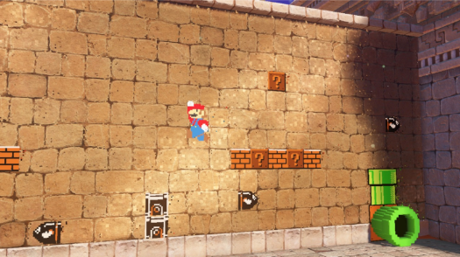
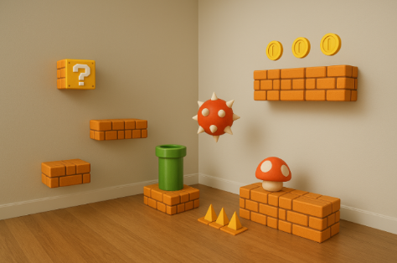
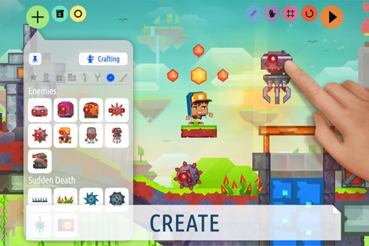
What is Raise Runner?
Mobile platforming game
Level editor
Augmented Reality mechanics
P1 Proposal’s mockups
Inspiration: Createrria 2

Slide 3

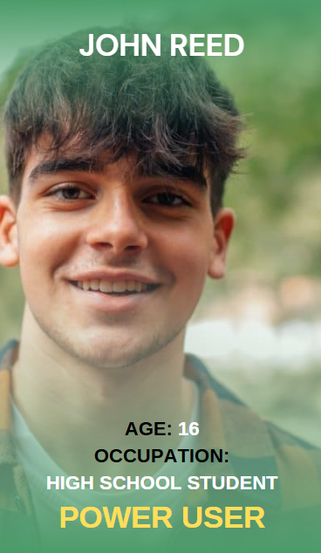
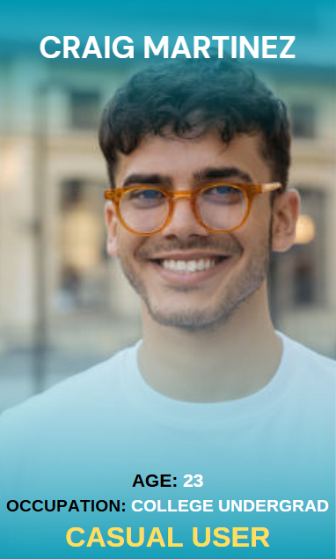
Target Audience

Slide 4
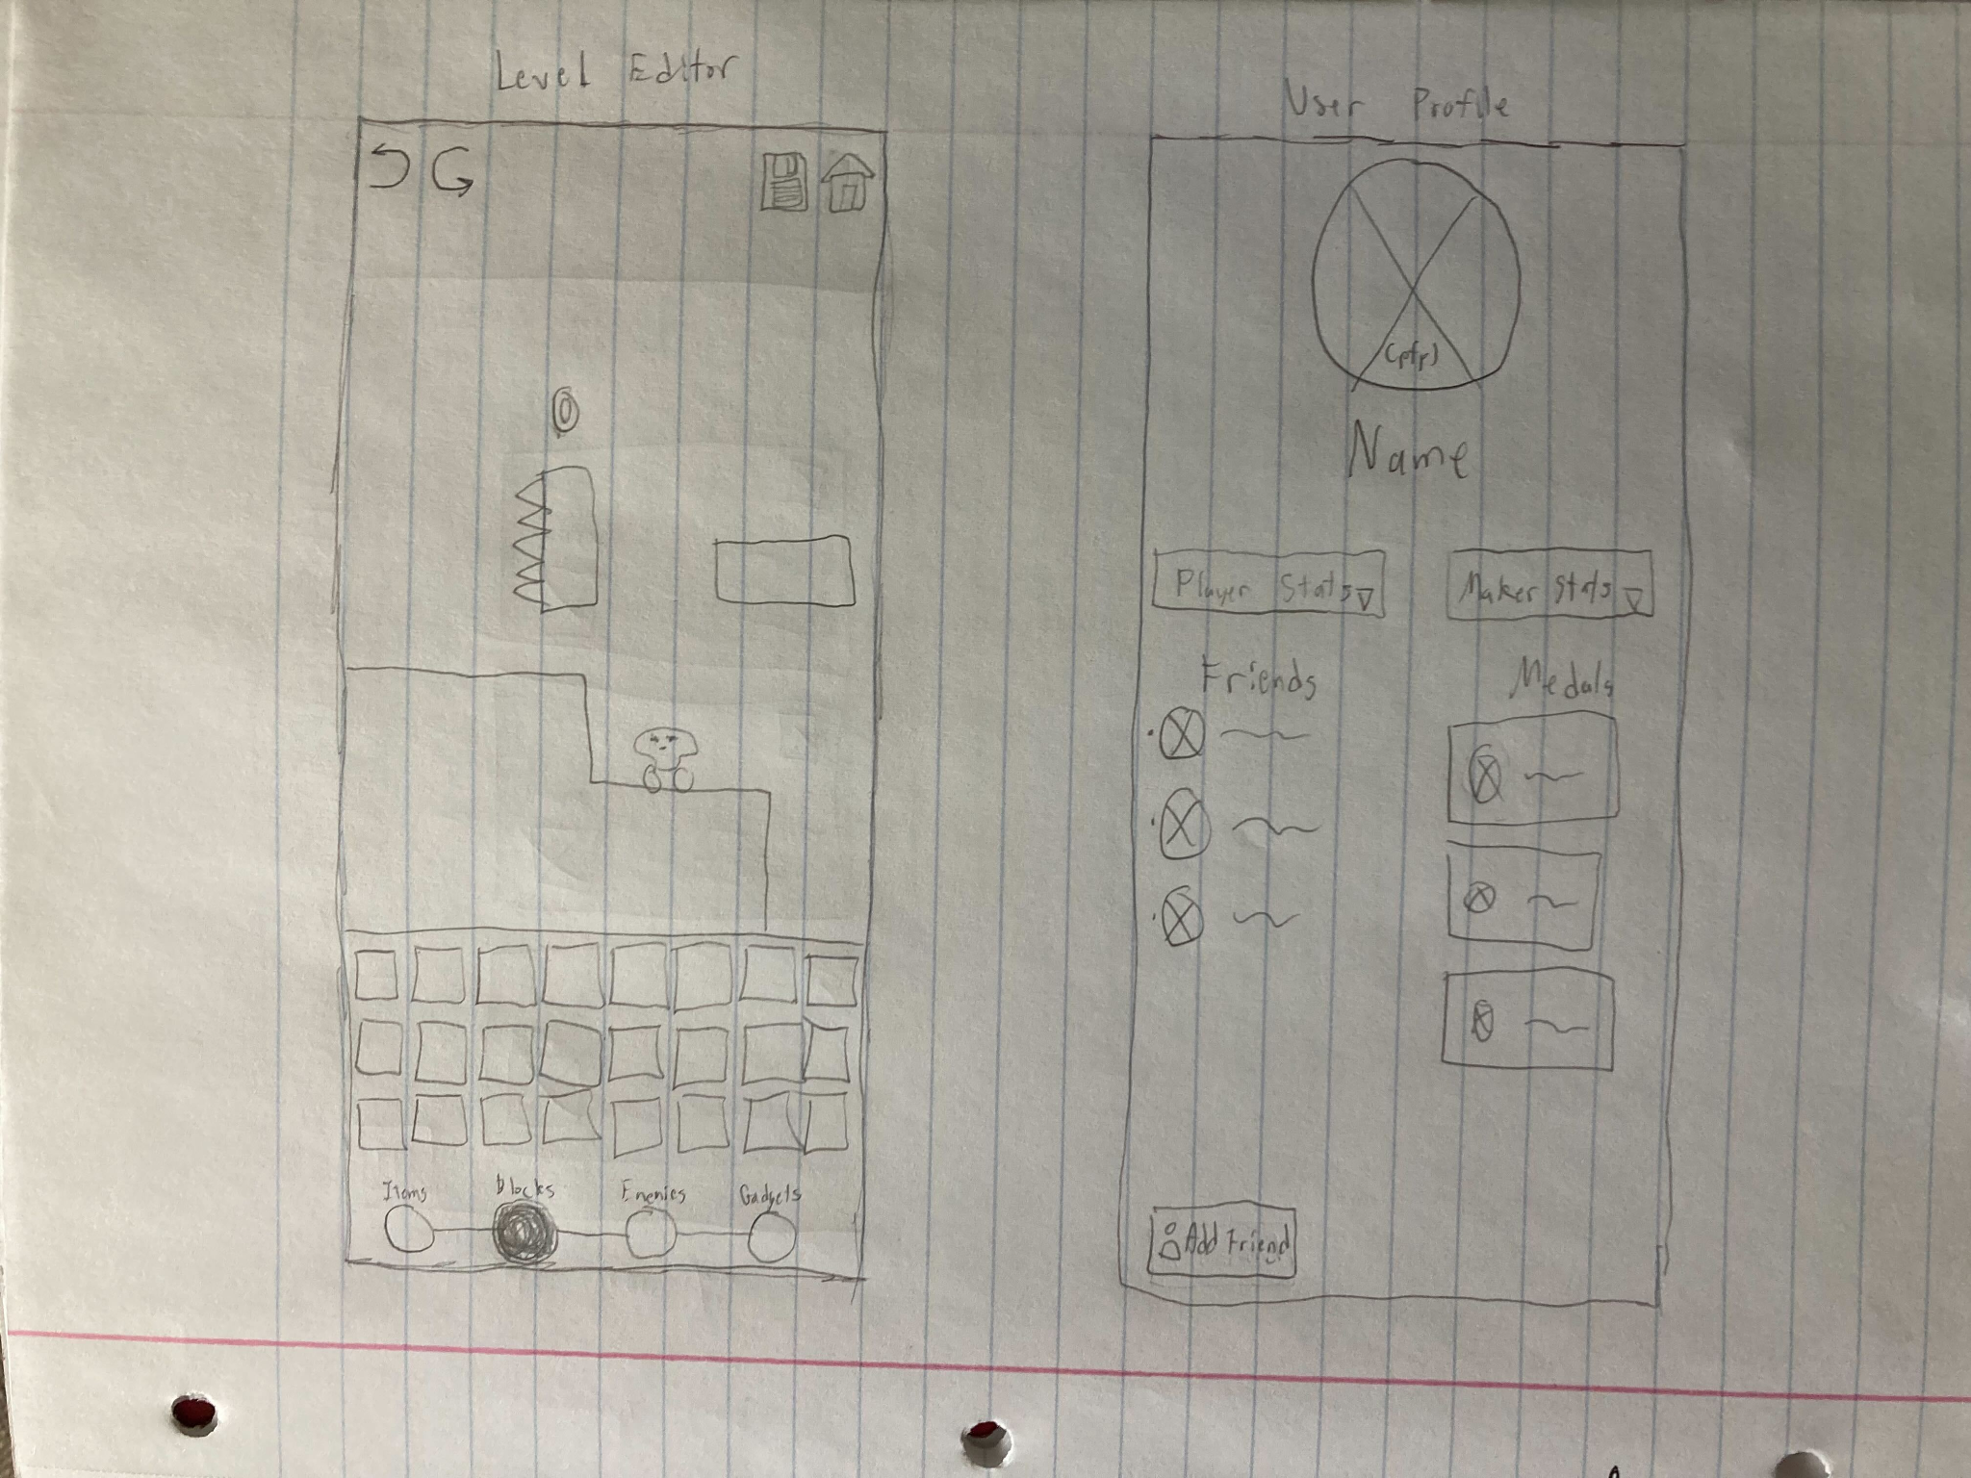
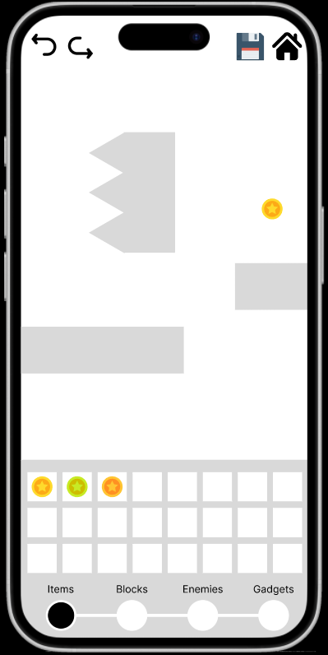
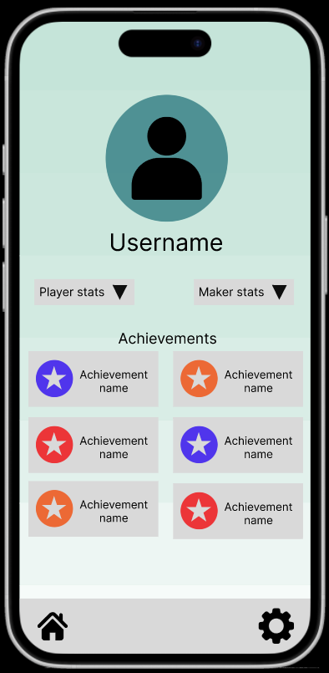
Project Evolution

Slide 5

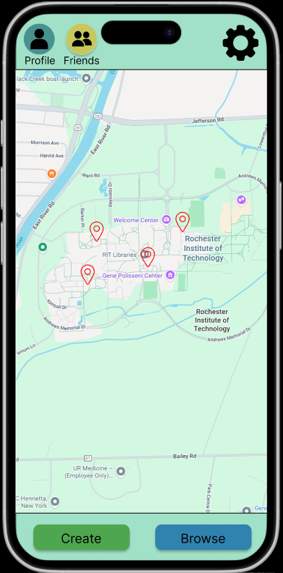
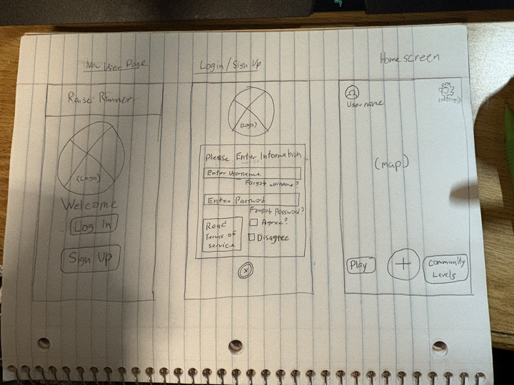

Slide 6
To the demo!

Slide 7
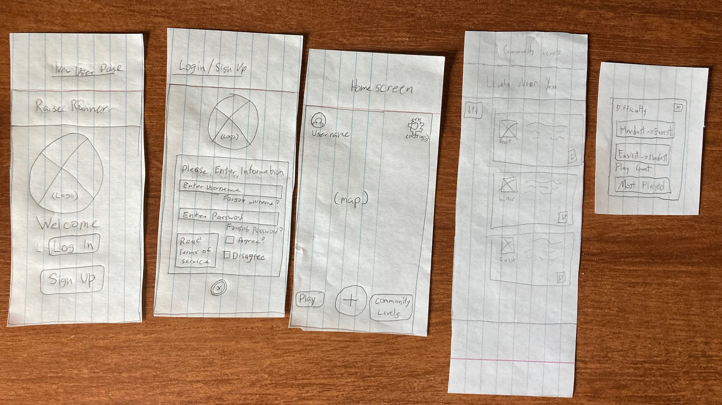
Testing Process

Slide 8
Conclusion

